Slide 1


Strategic Environmental Assessment For
Tartu Defense Centre

Slide 2

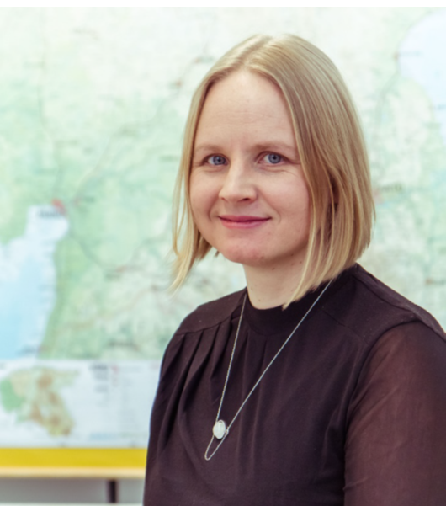
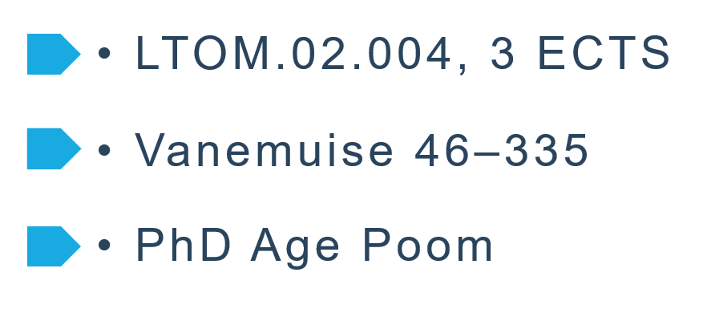

STRATEGIC ENVIRONMENTAL ASSESSMENT OF URBAN REGIONS
PhD Age Poom
Addressed themes
Background
Process
Methodology
Data
Effectiveness
Team Work

Slide 3
OUTLINE
Potential Locations and Baseline overview
Selection of Potential Locations
Cause – Effect Chain
5
Critical Decision-Making Criteria
4
6
Comparison of alternatives
3
7
Overview of Region
Mitigation Measures
2
8
Introduction
Public Involvement
1
9

Slide 4
INTRODUCTION
Find the best alternative for TDC location.
Comparing locations against each other.
The main criteria of the SEA.
Cover both social and environmental impacts.
Choose the suitable location
SEA
Strategic Environmental Assessment (SEA) has been implemented
Serve the purpose of assessing the impacts of the TDC at all possible locations
Relocate the Tartu Defense Centre
The City of Tartu has asked the Estonian Ministry of Defense to relocate the TDC in Raadi near the Estonian National Museum to another location
Criteria
The possible locations are based on a set of criteria that considers the City of Tartu’s Comprehensive Plan and needs of the TDC

Slide 5
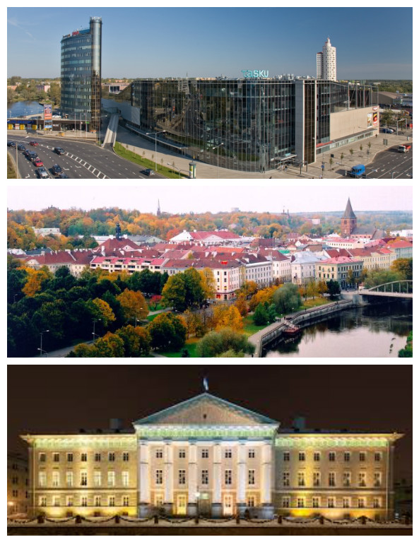
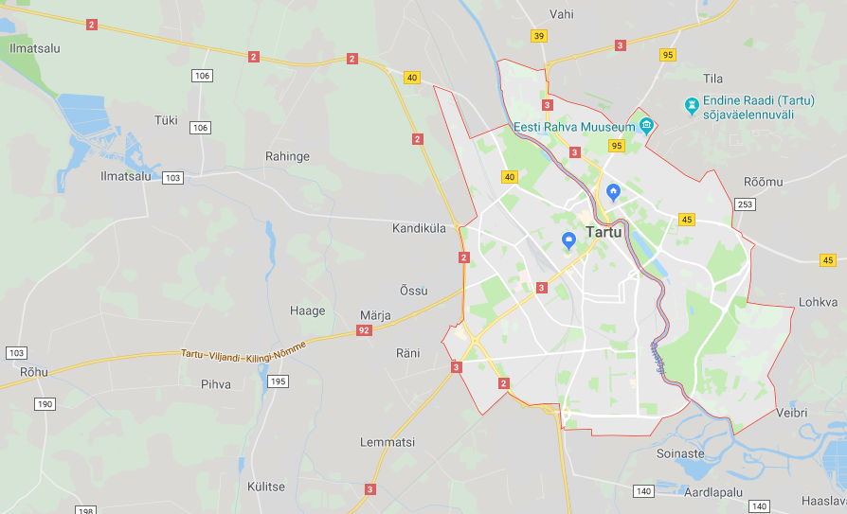
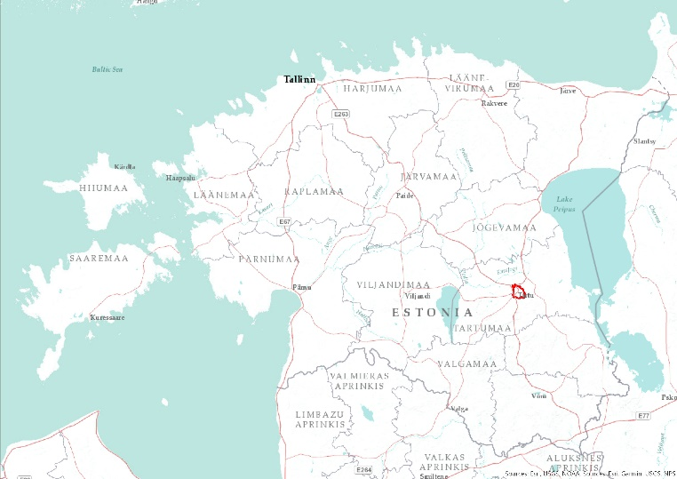



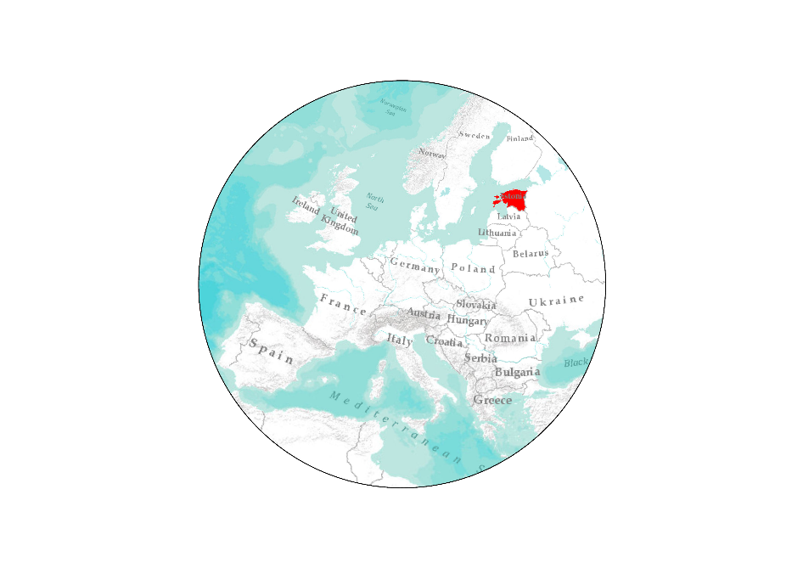



REGION
TARTU
Geographical location of Tartu city
Basic Information
Country: Estonia
T
Area: 38.8 km2
Population: 93 715
Density: 2508.6/km2
Rachid Berghout
From top to bottom: City Centre, Old Town of Tartu, University of Tartu.
Source: Wikipedia
Coordinates: 58°23′N 26°43′E
Tartu
T
*2017 estimate
Source: Wikipedia

Slide 6
Decision-Making Criteria
Sewage
Roads
Noise
Water
Fauna
Flora
Soil
Power
supply
Infrastructure
Current land use
Environmental Issues
Water
Accessibility to services
Protected
areas
Air
Planned development
Residential effects
Cost effectiveness

Slide 7
Selection of Potential Locations
No more than 5 km from Tartu city
No less than 25 hectares
Potential Locations
Not Within restricted areas – water or nature protected zones
Attribute query on result to select cadastral
plots with area no less than 25 hectares
not be current build up residential, commercial or industrial areas
Spatial query using created buffer with extracted area so get intersected cadastral plots from previous step
should not interfere with development plans of Tartu city and municipality
Attribute query on cadastral plots polygons to select only with particular land use types
within a reasonable distance from current infrastructure – road network and utilities
Extraction of unsuitable zones from buffer polygon
Preferably should be in state or municipal ownership
Construction of 5 km buffer around Tartu city borders
Should be suitable cadastral land use type

Slide 8
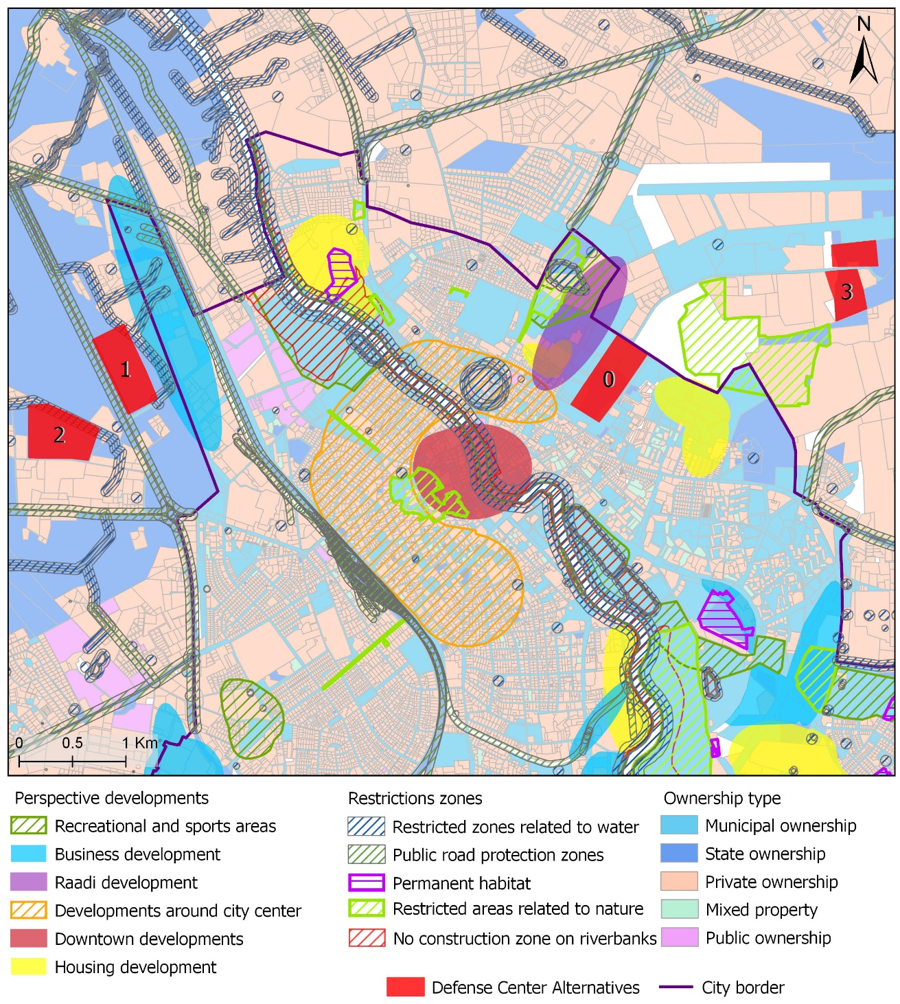

Spatial analysis results: potentially suitable cadastral
plots and buffer zone without restrictions
Defined National Defense Center alternatives

Slide 9
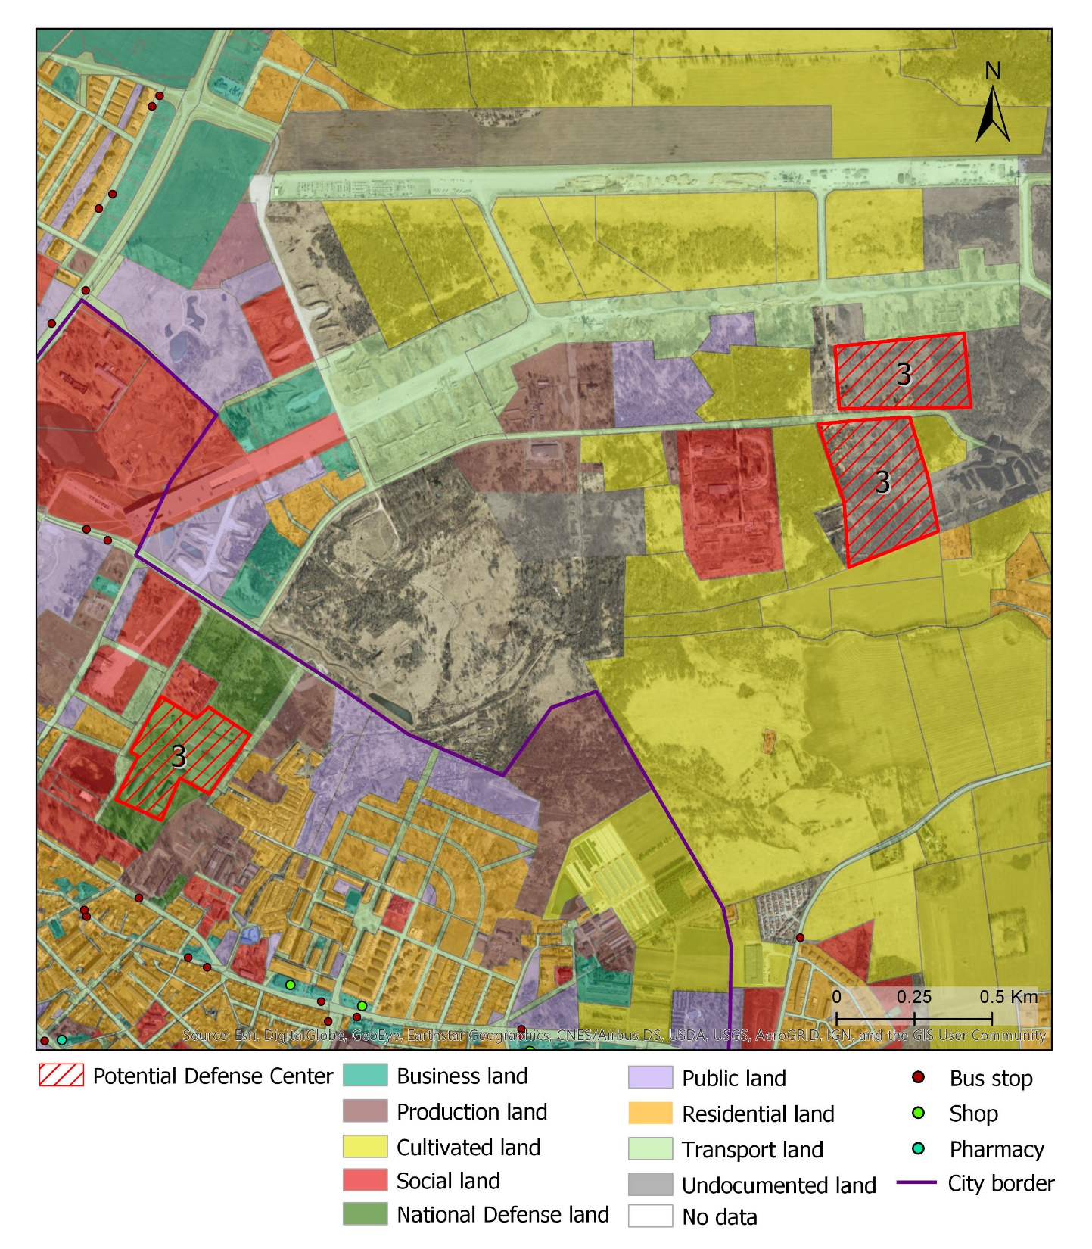
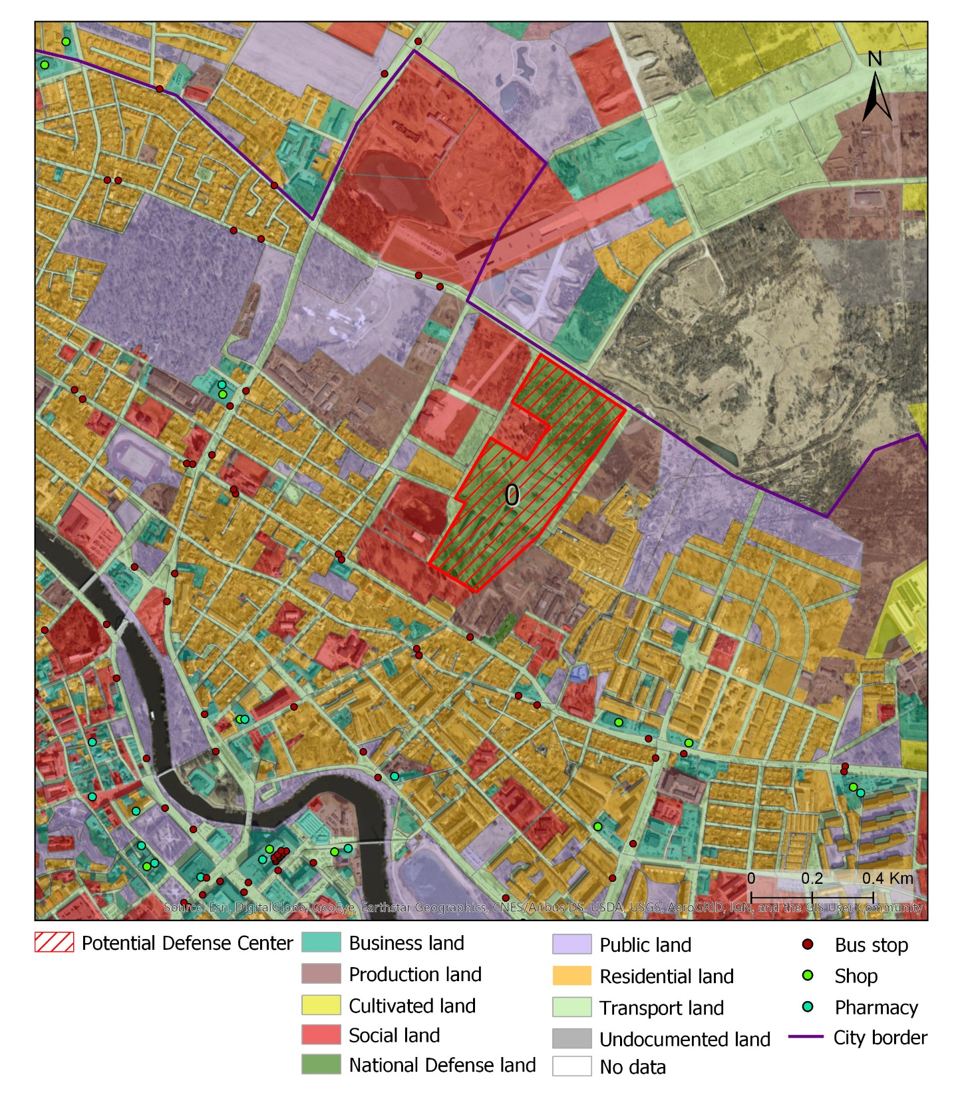
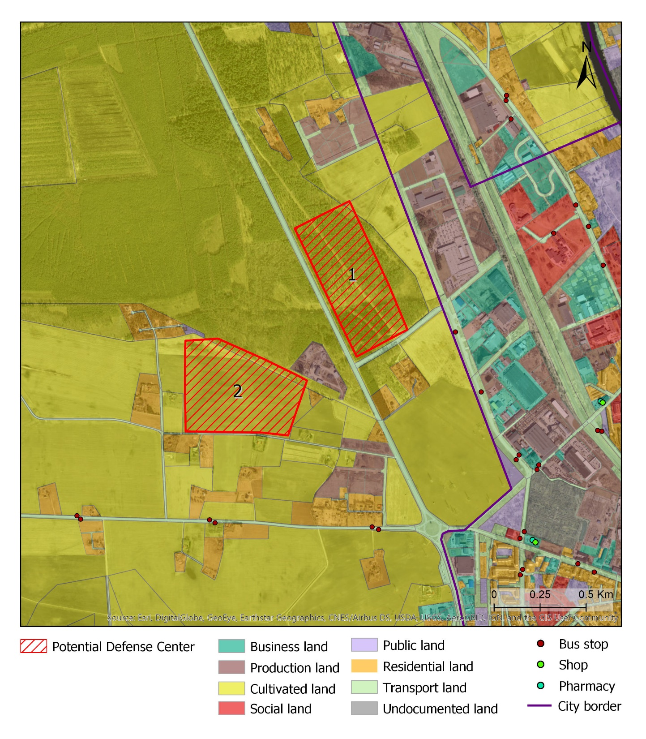
Potential Locations/Baseline overview
Environment
Cost-effectiveness
Infrastructure
Current land use
planned developments
Residential effects
Accessibility to services

Slide 10

Cause-effect chain
Source
Location of Defense center
Pressure
Clearing of land
Noise
Traffic
Land use change
Target area
Recreational areas
Surroundings
Road corridor
Receptor
Residents
Soil
Flora/Fauna
Air
Water
Impact
Stress and disturbance
Soil sealing
Destruction of Flora and Fauna
Air pollution
Water quality
Location 1
Human Health
Location 2
Location 3
Location 4

Slide 11
Location 0
Location 2
Location 3
Weight
Location 1
Comparison of alternatives
Environment
0,490 | 0,5985 | 0,041 | 0,029 | 0,136
Cost-effectiveness
0,205 | 0,154 | 0,154 | 0,154 | 0,031
Infrastructure
0,076 | 0,030 | 0,032 | 0,013 | 0,012
Current land use
0,043 | 0,002 | 0,027 | 0,013 | 0,003
planned developments
0,097 | 0,010 | 0,043 | 0,043 | 0,141
Residential effects
0,041 | 0,033 | 0,004 | 0,002 | 0,012
Accessibility to services
0,048 | 0,041 | 0,003 | 0,003 | 0,016
Summarized weights
 | 0,871 | 0,3071 | 0,260 | 0,354
Rank
 | 1 | 4 | 3 | 2

Slide 12
Mitigation Measures
Criteria
Type of mitigation measures
Location 0
Planned development | Construction measures (long-term)
Cost effectiveness
Location 1
Environmental issues | Procedural (Reduce negative impacts)
Current land use | Spatial regulative
Location 2
Infrastructure | Technical, repair
Accessibility to services | Fiscal ( compensate negative impacts)
Location 3
Planned development | Spatial regulative

Slide 13
Public Involvement
Parties
Why
When
Ministry of Defense
Maintain the property due to the standards of national defense policy | Very beginning
City Council
Pushing the change and its effects Represent the constituents | Very beginning
Planning Personnel
Planning principles, developments, and environmental policies | Very beginning
Utilities expert
What can and cannot be done with utilities and each option providing financial estimates | Once
Environmental experts
More in-depth information environmental policies Expressing concerns Providing mitigating options | Once
Local citizens / business
Voice their concerns through public forums feel a part of the community and the planning process | Last revisions

